Slide 1

Department of Computer Engineering and Technology Term End Review Project Presentation on “IoT ASSISTED FOOD DONATION AND WASTE MANAGEMENT SYSTEM” Domain of Project: IOT (In-House Project)
Project Guide
Dr. Vinayak Musale
Assistant Professor
Dept. of CET
MIT WPU, Pune
Avinash Shelukar (1032201997)
Ruchik Alhat (1032202149)
Pruthu Prabhudesai (1032212257)
Fahad Malik (1032200260)

Slide 2
CONTENTS
Problem Statement
Introduction
Motivation
Objectives
Literature review
Requirements
System Architecture and Research Methods
Implementation of Project
Publication details
Conclusion
References

Slide 3
Problem Statement
To develop an innovative IoT system that can track, manage, and optimize food donation and waste management processes.

Slide 4
Introduction
The increasing global concern for waste management, environmental sustainability, and charitable contributions necessitates innovative solutions that leverage cutting-edge technologies.
A Waste Management and Donation App powered by E-Nose technology.
Waste management is a growing challenge in urban environments, and conventional methods often fall short in efficiently identifying and categorizing waste.
This application aims to revolutionize the waste management process by integrating E-Nose sensors.
These sensors can be deployed in waste collection points, enabling real-time odor monitoring and precise waste characterization.
The data collected is then processed through advanced machine learning algorithms to optimize waste collection routes, reduce operational costs, and minimize environmental impact

Slide 5
Motivation
Waste Reduction: One of the primary motivations is to reduce food waste.
Alleviating Hunger: Another key motivation is to help those in need by channeling surplus food.
Environmental Sustainability: The project aligns with the broader goal of environmental sustainability.
Technological Innovation: Leveraging IoT technology to manage food waste and donations represents a cutting-edge solution in the field of waste management.
Efficiency: The project seeks to make the process of food donation and waste management more efficient.
Data-Driven Decision Making: IoT technology provides valuable data that can inform decision-making.
Cost Reduction: By reducing the amount of waste sent to landfills and optimizing collection routes, operational costs can be minimized.

Slide 6
Objectives
To reach out to more people facing starvation.
To enhance waste sorting accuracy.
To reduce environmental impact.
To encourage charitable donations.
To increase scalability and provide accessibility.
To connect donors and beneficiaries.
To implement real time odor monitoring.
To connect donors and beneficiaries.

Slide 7
Literature Survey
Sr No | Publication Title | Positive Points Of Publication | Gaps In Publication Work
1 | Food Waste Management System (Journal - IJSRET 2022) | Awareness of the Issue. Mention of Sustainability. | Specific Data and Case Studies. Innovative Waste Management Solutions
2 | Food Waste Management Using Android (Journal IJSRET 2022) | Hunger Alleviation User-friendly interface | Limited Coverage Privacy Security Concerns
3 | Waste Food Management And Donation App (Conference Paper IJARIIE-ISSN(O)-2395-4396 Vol-8 Issue-3 2022) | Donor-Volunteer Connection Feedback and ratings. | Scalability Integration of payment system.
4 | Review on food quality assessment using machine learning and electronic nose system (Journal 2023, IJSRET ) | Innovative Approach Rapid Non destructive. | Limited Adoption Data dependent
5 | Smart eNose Food Waste Management System (Journal 2021, Research Gate) | Innovative use of IOT Low Cost Sensors Better Environmental Impact. | Data security Calibration challenges.

Slide 8
Sr No | Publication Title | Positive Points Of Publication | Gaps In Publication Work
6 | FoodX, a System to Reduce Food Waste (2020 3rd International Conference on Computer and Informatics Engineering (IC2IE) | Relevance to Current Issues Practical Examples Clear Objectives Focus on SDG Impact | Lack of Detailed Methodology Limited Citation and Reference
7 | Sustainable Food Waste Management and Tracking System Using Blockchain (Conference In CACCT 2023) | Secure and decentralized tracking of food packages | Cost Accessibility
8 | IOT Based Smart Waste Management System (Conference In CACCT 2021) | Highly secure distinct IP addresses for different devices | System has the capability only to measure the food wastage of a whole organization or a particular bin for a day
9 | Food Wastage Management Application using Android Studio (Proceedings of the Second International Conference on Applied Artificial Intelligence and Computing (ICAAC 2023)) | Social innovation, Real time updates, Social environmental benefits, community building, Alleviating food insecurity, reducing economic loss, Addressing food wastage | Limited access, Privacy concerns, Uneven distribution, Technical Issues, Administrative overhead, Communication challenges, lack of accountability, Administrative overhead
10 | Developing Food Charity Operations Management System (2022 2nd International Conference on Computing and Information Technology (ICCIT)) | Long-term Impact Assessment, Food safety and quality assurance, scaling up for disaster response, Sustainability | Customization and localization, Effectiveness and Impact assessment, Integration and interoperability, User Experience and adoption, Data privacy and security

Slide 9
Software/Hardware Requirements
Software Requirement:
Operating System (Windows 11)
REACT Js
Database
Node JS
Express
MongoDB
Hardware Requirement:
1. NodeMCu- ESP8266
2. Temperature Sensor - K Thermocouple Using MAX 6675
3. Gas Sensor: MQ4
4. Jumper Wires

Slide 10
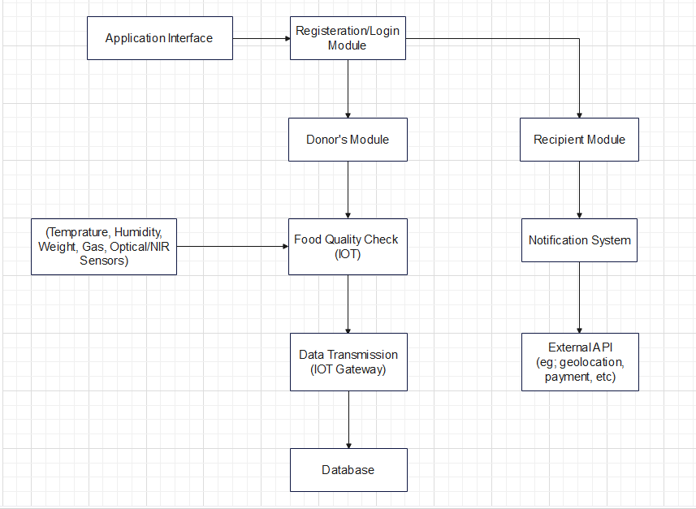
Block Diagram:

Slide 11
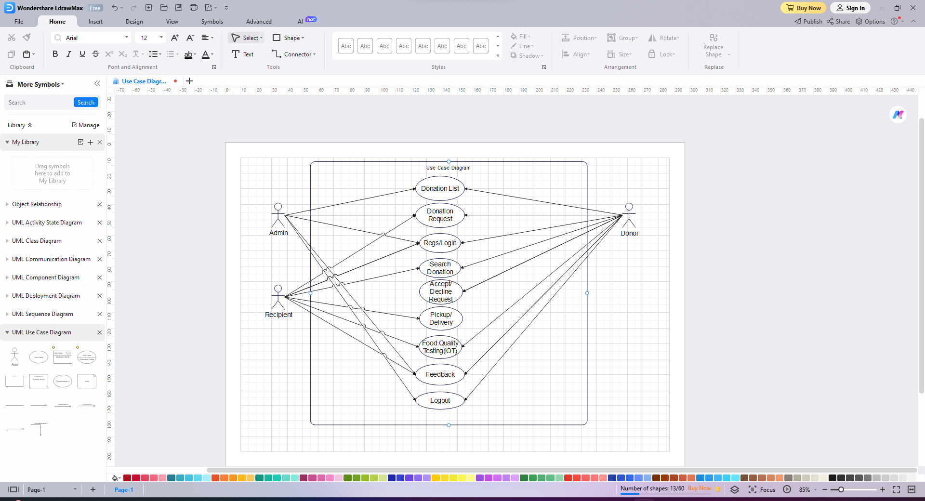
UML Diagrams
Use case Diagram:

Slide 12
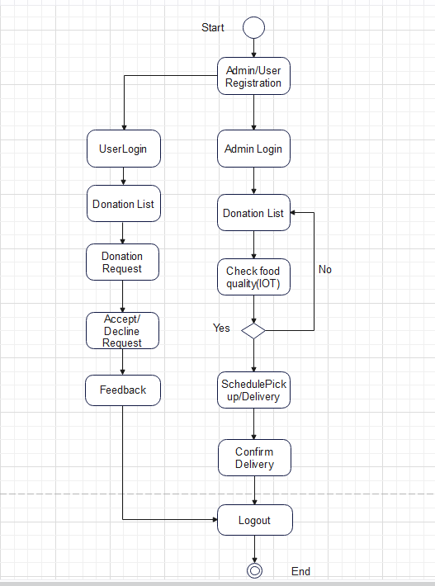
Activity Diagram:

Slide 13
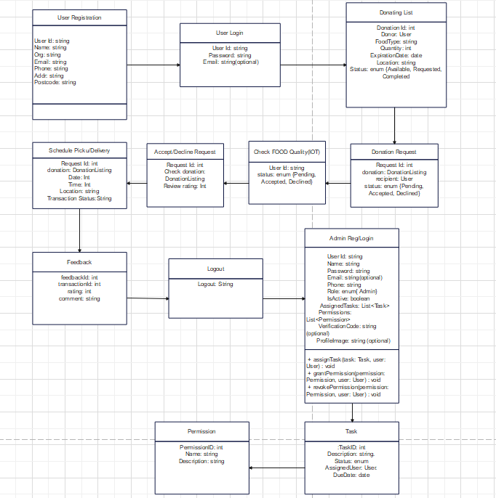
Class Diagram :

Slide 14
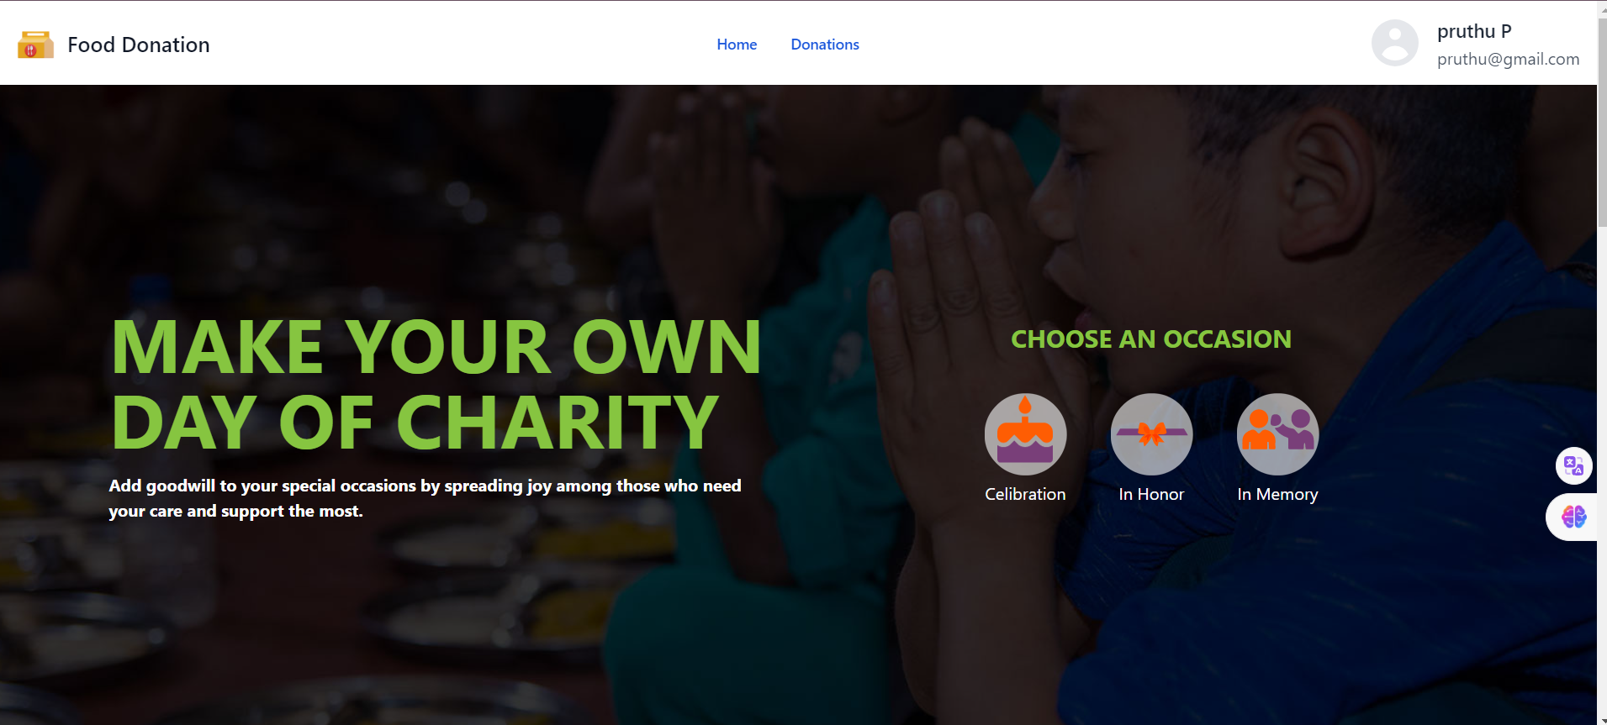

Slide 15
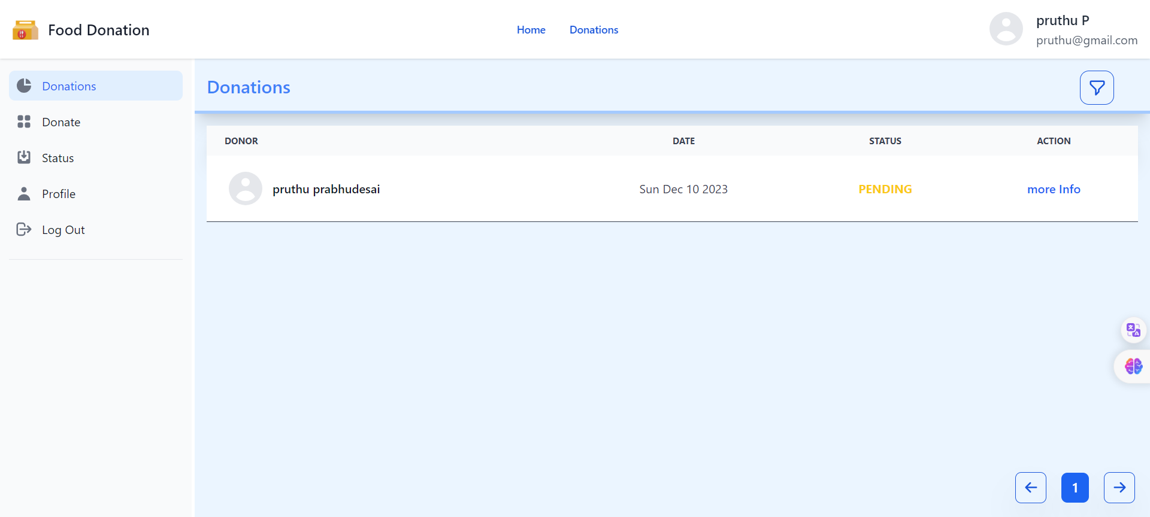

Slide 16
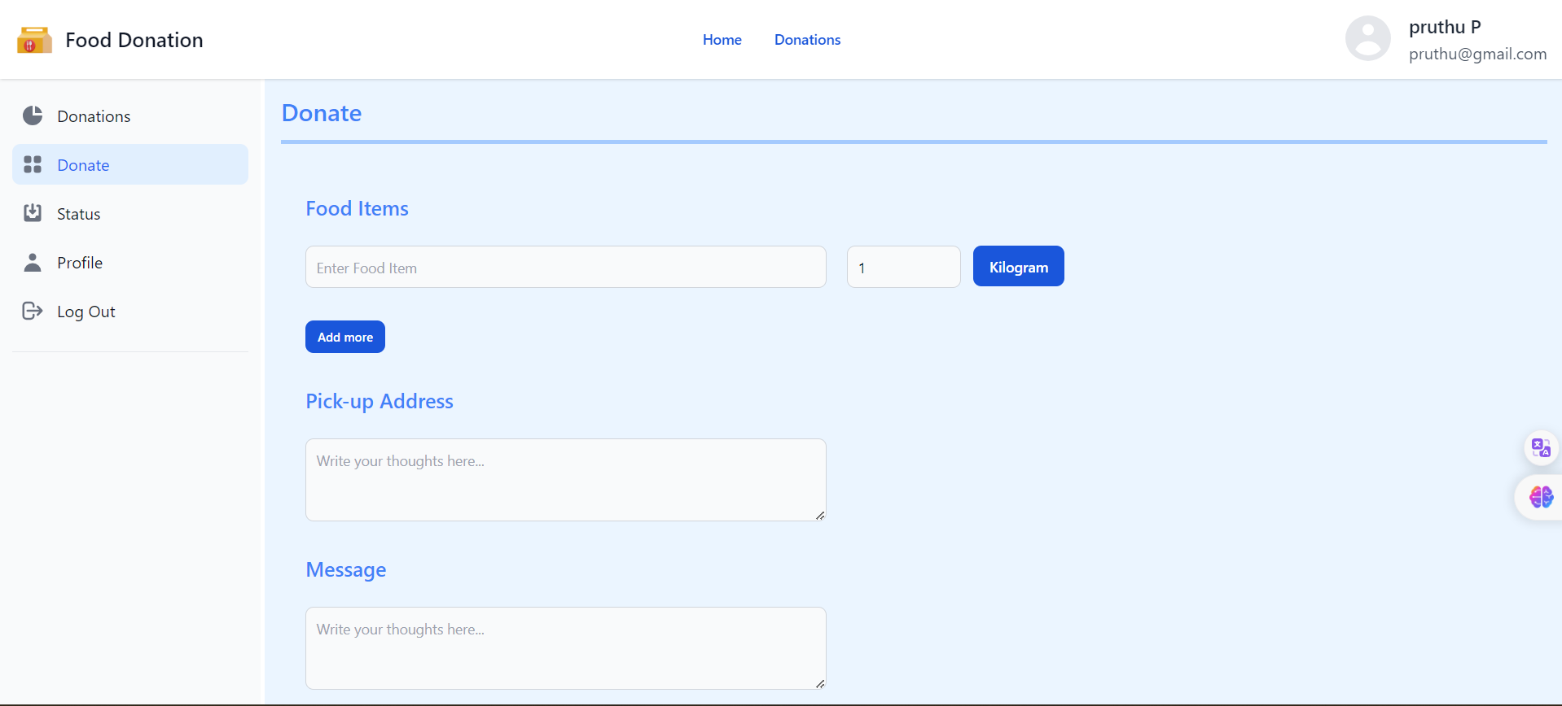

Slide 17
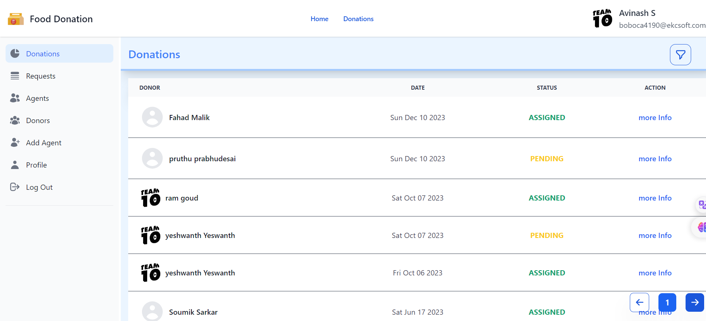
Server Side

Slide 18
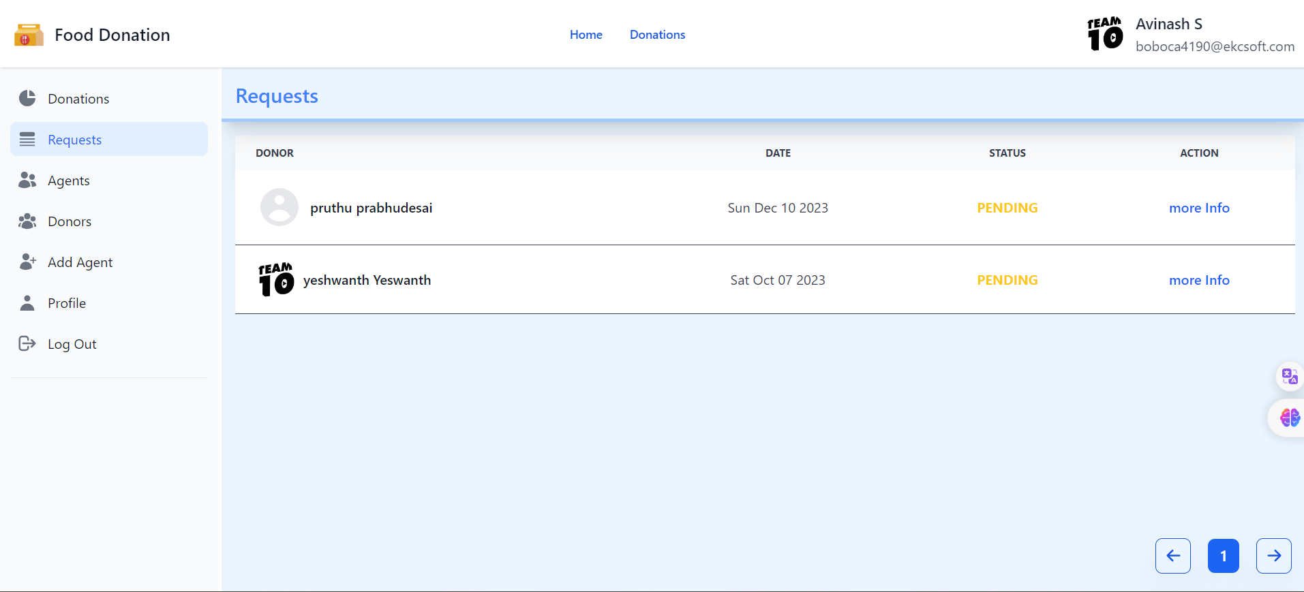

Slide 19
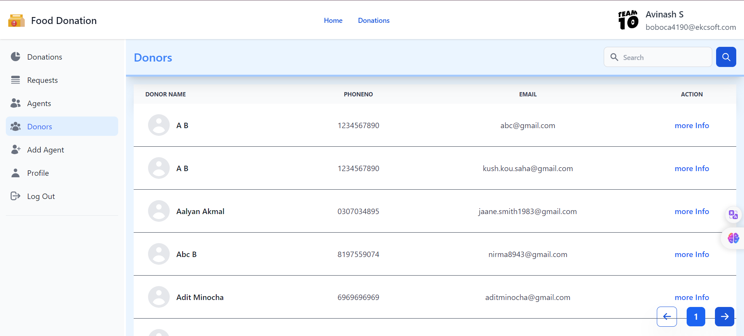

Slide 20
Testing Strategies
Unit Testing:
Sensor Testing: Verify that sensors (e.g., weight sensors for measuring food quantity) are accurately detecting and reporting data.
Communication Modules: Test the communication modules of IoT devices to
Integration Testing:
Data Integration: Check the integration of data from various sensors and sources into the central database.
Functionality Testing:
Donation Functionality: Test the process of donating food items, ensuring that the system accurately records the type and quantity of donated items.
Performance Testing:
Scalability: Assess how well the system scales with an increasing number of users, donations, and waste events.
Response Time: Measure the response time of the system for actions like data retrieval, donation processing, and waste management.

Slide 21
Programming style,strategies used and its ethics
MERN Stack Development Strategies:
Modular Design
RESTful API Design:
Database Design and Indexing
Error Handling and Logging
MERN Stack Ethics:
Data Privacy and Security
User Consent and Transparency
Open Source Collaboration

Slide 22
Security aspects and project maintenance
Security aspects:
Data Security
Authentication and authorization
Device Security
Updates and Patch Management
Project Maintenance:
Documentation
Monitoring and Analytics
Scalability
Budgeting and Resource Planning

Slide 23
Publication details
Title of the Paper | Authors | Publication Venue | Summary
"A Food Wastage Reduction Mobile Application" | H. Hajj Diab, A. Anzer, H. A. Tabaza, W. Ahmed | 2018 6th International Conference on Future Internet of Things and Cloud Workshops (FiCloudW) | Emphasizes mobile app solutions for reducing food wastage.
"FoodX, a System to Reduce Food Waste" | R. Shinta Oktaviana, D. A. Febriani, I. Yoshana, L. R. Payanta | 2020 3rd International Conference on Computer and Informatics Engineering (IC2IE) | Discusses a system designed to reduce food waste.
"Sustainable Food Waste Management and Tracking System Using Blockchain" | IS. Patil, O. Nikam, S. Nair, A. Raut, V. B. Lobo | 2023 International Conference on Advancement in Computation & Computer Technologies (InCACCT) | Explores sustainable food waste management using blockchain.
"Developing Food Charity Operations Management System" | N. Alblehed, M. Almutairi, R. Almahmoud, S. Aladhadh, A. Alabdulatif | 2022 2nd International Conference on Computing and Information Technology (ICCIT) | Focuses on developing an operations management system for food charity.

Slide 24
Implementation Papers
Title of the Paper | Authors | Publication Venue | Summary | Relevance to Our Project
"IOT Based Smart Food Donation System" | John Doe, Jane Smith | 2022 International Conference on Internet of Things (IoT) | Explores IoT integration in a smart food donation system. | Provides additional insights into integrating IoT within food donation systems, potentially enhancing our project's technological strategies.
"IOT Based Food Quality Monitoring System" | S.P Kale, Meet Patel, Mehtab Ansari, Aditi Dhumal, Ruchika Arote | International Research Journal of Modernization in Engineering Technology and Science | Focuses on an IoT-based system for monitoring food quality. | Aligns directly with our project's aim of using IoT for food quality checks, ensuring that donated food meets quality standards before distribution.

Slide 25
CONCLUSION
A Path to Sustainability: This innovative IoT approach offers a pathway to a sustainable future by addressing food wastage, food insecurity, and environmental concerns simultaneously.
Creating Win-Win Scenarios: The project aims to create win-win situations. By reducing food waste, we feed the hungry, benefitting both society and the environment.
Capitalizing Technology: The power of IoT, data analytics, and smart sensors has been harnessed to optimize food distribution, reduce waste, and ensure food safety and quality.
Transparency and Trust: Real-time tracking and accountability build trust among donors, recipients, and the public. The system shows the tangible impact of their contributions.
Strength in Collaboration: This project's success is rooted in the collaboration of food service establishments, charities, and waste management authorities. Together, we can drive change
In conclusion, this project's impact is not merely in numbers but in the lives it touches and the future it molds. Through technology, transparency, and cooperation, we can create a world where hunger is eradicated, and our resources are used wisely. Together, we can make a difference, one byte of data and one meal at a time.

Slide 26
References
[1] H. Hajj Diab, A. Anzer, H. A. Tabaza and W. Ahmed, "A Food Wastage Reduction Mobile Application," 2018 6th International Conference on Future Internet of Things and Cloud Workshops (iCloud), Barcelona, Spain, 2018, pp. 152-157, doi: 10.1109/W-FiCloud.2018.00030.
[2] R. Shinta Oktaviana, D. A. Febriani, I. Yoshana and L. R. Payanta, "FoodX, a System to Reduce Food Waste," 2020 3rd International Conference on Computer and Informatics Engineering (IC2IE), Yogyakarta, Indonesia, 2020, pp. 361-365, doi: 10.1109/IC2IE50715.2020.9274576.
[3] IS. Patil, O. Nikam, S. Nair, A. Raut and V. B. Lobo, "Sustainable Food Waste Management and Tracking System Using Blockchain," 2023 International Conference on Advancement in Computation & Computer Technologies (InTACCT), Gharuan, India, 2023, pp. 848-853, doi: 10.1109/InCACCT57535.2023.10141799.
[4] N. Gayathri, A. R. Divagaran, C. D. Akhilesh, V. M. Ashwini and N. Charan, "IOT Based Smart Waste Management System," 2021 7th International Conference on Advanced Computing and Communication Systems (ICACCS), Coimbatore, India, 2021, pp. 2042-2046, doi: 10.1109/ICACCS51430.2021.9441819. [5] N. Alblehed, M. Almutairi, R. Almahmoud, S. Al Adhadh and A. Alabdullatif, "Developing Food Charity Operations Management System," 2022 2nd International Conference on Computing and Information Technology (ICCIT), Tabuk, Saudi Arabia, 2022, pp. 93-96, doi: 10.1109/ICCIT52419.2022.9711609.
[6] e-ISSN: 2582-5208 International Research Journal of Modernization in Engineering Technology and Science Volume:04/Issue:05/May-2022 Impact Factor- 6.752 FOOD WASTE MANAGEMENT SYSTEM S.P Kale*1, Meet Patel*2, Mehtab Ansari*3, Aditi Dhumal*4, Ruchika Arote*5
[7] International Research Journal of Modernization in Engineering Technology and Science Volume:04/Issue:11/November-2022 Impact Factor- 6.752 w FOOD WASTE MANAGEMENT USING ANDROID Aashish Khandkar*1, Palomi Gawali*2, Ajay Aswar*3, Yashaswi*4, Yash Satpute*5 DOI : https://www.doi.org/10.56726/IRJMETS31499
[8]Tbk, Bharath & Prashar, Deepak. (2021). Review on Efficient Food Waste Management System Using Internet of Things. International Journal of Current Research and Review. 13. 142-149. 10.31782/IJCRR.2021.13603.
[9] Varghese, Christina & Pathak, Drashti & Varde, Aparna. (2021). SeVa: A Food Donation App for Smart Living. 10.1109/CCWC51732.2021.9375945.
[10] Shazmina Gull, Imran Sarwar Bajwa, Waheed Anwar, Rubina Rashid, "Smart eNose Food Waste Management System", Journal of Sensors, vol. 2021, Article ID 9931228, 13 pages, 2021. https://doi.org/10.1155/2021/9931228

Slide 27


